Slide 1
LECTURE
Use Cases
Waris Ali

Slide 2
Unified Modeling Language - UML
It is a language used for :
  Specification
  Construction
  Visualization
  Documentation of software systems
Diagrams to consider:
Use-Case Diagram
Sequence Diagrams
Activity Diagrams
Class Diagrams
DFD (Data Flow Diagram)
Contex Diagrams

Slide 3
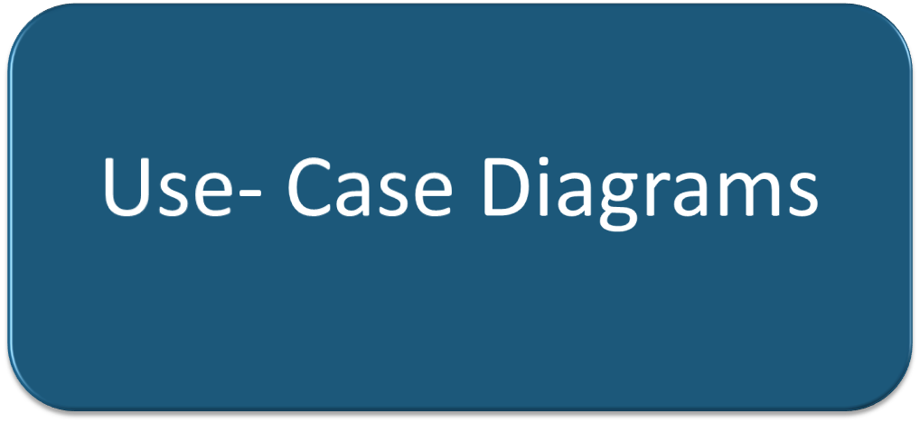

Slide 4
Use-Case
Definition
  Describes a ‘task’ that a user can perform using the system.
  E.g. Issue Books, Return Books, Become Member etc.
Description
  Describes « Functional » requirements of a system
  What a user can do with the system.

Slide 5
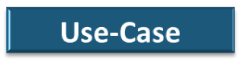


Use-Case (Contd.)
Functional Requirements that the user can perform
No. and use
case name
<<Actor>>
SYSTEM

Slide 6
Actors
Actor is any external entity which is involved in the interaction with the system
  Person – Human (Student, Teacher, User, Patient etc)
  Any External System – (Database, Remote Control System etc.)
Symbol

Slide 7
Generalization/Specialization of Actors
CLERK
Accounts Clerk
Admin Clerk
Exam Br. Clerk

Slide 8
Use-Case Diagram
Shows the relationships between a set of use-cases and the actors involved in the use-cases
Steps while drawing Use-case Diagram:
  Identify Use-Cases
  Identify Actors
  Build relationships between actors and use-cases
  Build relationships between use-cases
  Construct Diagram

Slide 9
Constructing Use-Case Diagram
PACKAGE NAME or System

Slide 10
Lets build a use-case diagram together!

Slide 11
Scenario:
ATM provides the following services:
Distribution of money to the holder of ATM Card via Cash Dispenser Machine
Report of Account Balance, Cheque Deposit Facilities to the Bank Customers who hold the ATM from their bank.
All transactions are recorded by the Bank Staff.
Dispenser has to be re-filled from time to time.
ATM should respond to customer request within a maximum time-limit of 02 seconds.
System should maintain the ‘confidentiality of the user’.
The failure rate should be less 10⁶
Swollen/Captured cards should be retreived on regular basis.

Slide 12
Identify Use-Cases
Distribution of money
Money Withdrawl
Check Account Balance,
Cheque Deposit
Cash Deposit
Transactions are to be recorded
Dispenser has to be re-filled
Captured Cards to be retrieved

Slide 13
Identify Actors
ATM Card Holder
Bank Customer
Bank Staff Officer

Slide 14
Build relationships between Actors and Use-Cases
ATM Card Holder withdraws money
Bank Customer consults balance
Bank Customer deposits cash
Bank Customer deposits cheques
Bank Staff Officer records transaction
Bank Staff Officer retrieves siezed cards
Bank Staff Officer re-fills dispenser.
Dispenser System distributes money

Slide 15

ATM System
Withdraws Money
Re-Fill Dispenser
Retrieve Seized Cards
Bank Staff
ATM Card Holder
Record Transactions
Check Balance
<<Actor>>
Dispenser System
Distributes Money
Deposit Cheques
Bank Customer
Deposit Cash

Slide 16
Railway Reservation

Slide 17
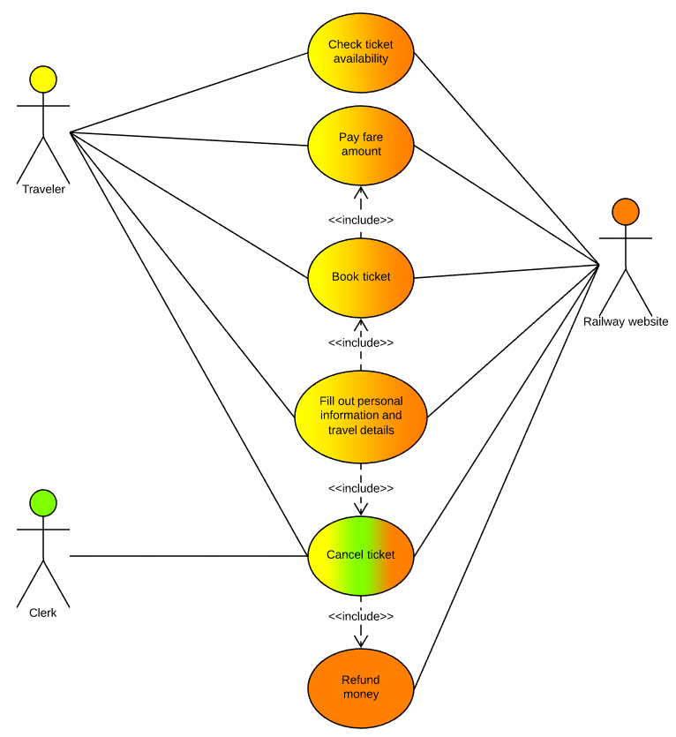
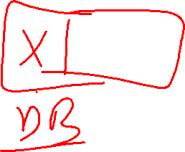
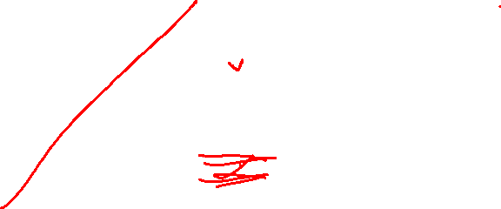

Slide 18
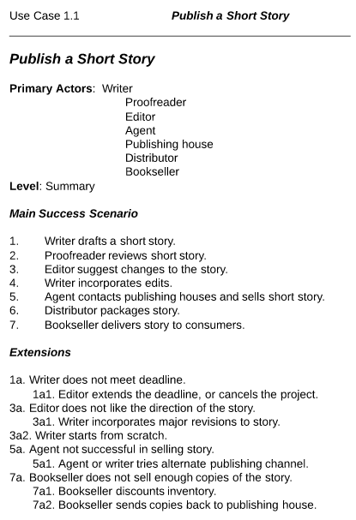

Slide 19
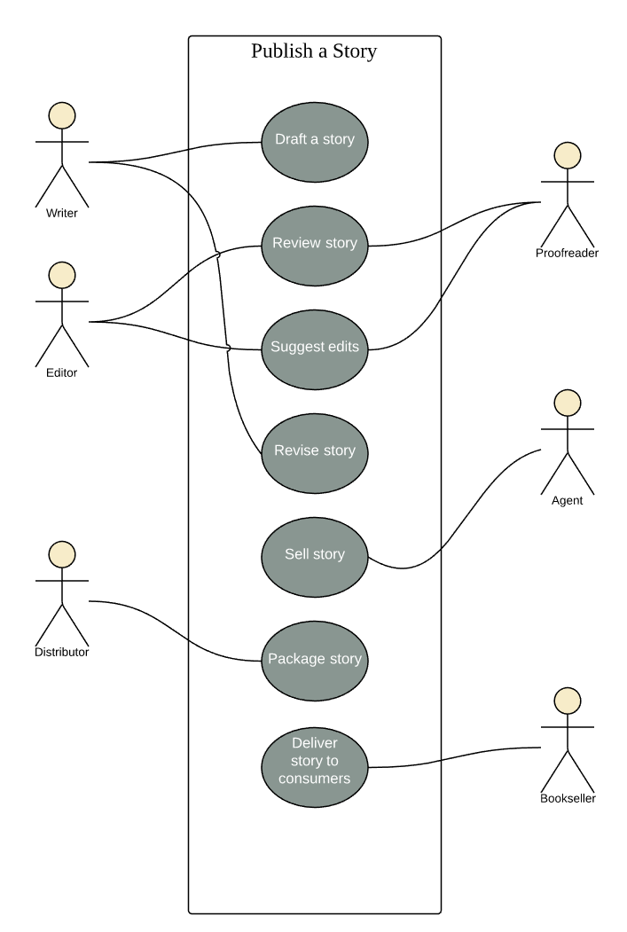

Slide 20
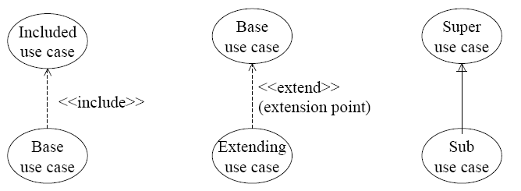
Relationships between use-cases
Include
  Base use-case includes the functionality of included use-case
Extend
  A use-case is optionally extended by functionality of another use-case
Generalization/Specialization
  Sub-Case inherits behavior and semantics from super use-case

Slide 21
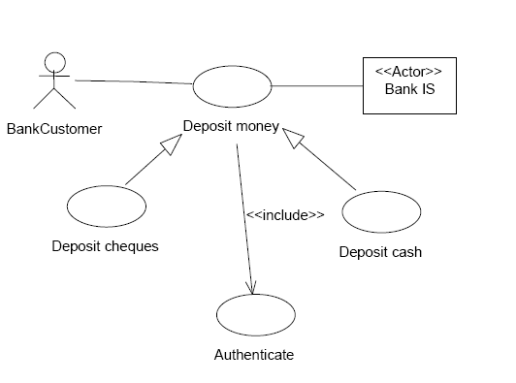
Example of Generalization relationship

Slide 22
QUESTIONS ?

